Slide 1
BUILDING ENTERPRISE FUND ADVISORY COMMITTEE
March 23, 2022

Slide 2
INTRODUCTIONS

Slide 3
Public comment

Slide 4
Review and approval of meeting minutes DECEMBER 6, 2021

Slide 5
Financial update

Slide 6
Capital project requests

Slide 7
Capital project requests
LED Lighting Upgrade - $2,080,968
Benefits of upgrading to LED Lighting fixtures
Brand new fixtures with a one year correction period including commissioning/light level confirmation by the contractor which in turn would be verified by our design team/RPM D&C
Fixture capable lighting level reduction or fixture shutdown based on occupancy.
Fixture and power usage measurement and reporting when combine with lighting panel upgrade.
Unverifiable yet it is estimated an annual energy cost savings of $22,004 for the 1st floor (Building & Fire Prevention) at 9¢ per Kwh.
Supports County mandate to reduce power consumption by 20% by 2023.
Reduce maintenance cost since all the old fixtures would be replaced with LED which can last from six to twelve years which could also include an extended warranty from the fixture manufacturer above the one year correction period.
Reduced heat emissions from LED reducing HVAC operating cost, though not verifiable

Slide 8
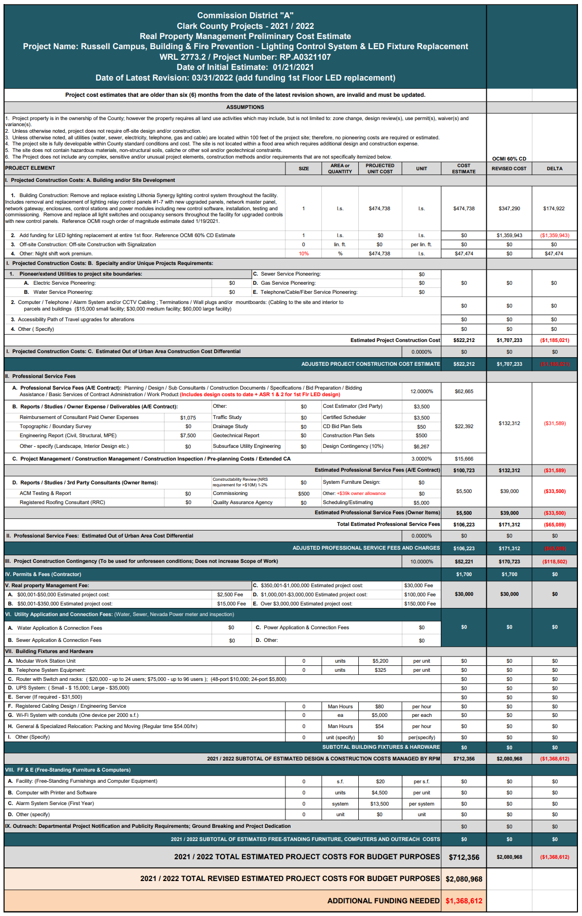
Page 1 of 2
LED Lighting Upgrade

Slide 9
Page 2 of 2
LED Lighting Upgrade

Slide 10
Capital project requests
Russell Campus Boiler Replacement - $1,257,138
Scope of Work
Replacement of boilers at Russell Campus with high efficiency boilers.
Current boilers reaching end of useful service period.

Slide 11
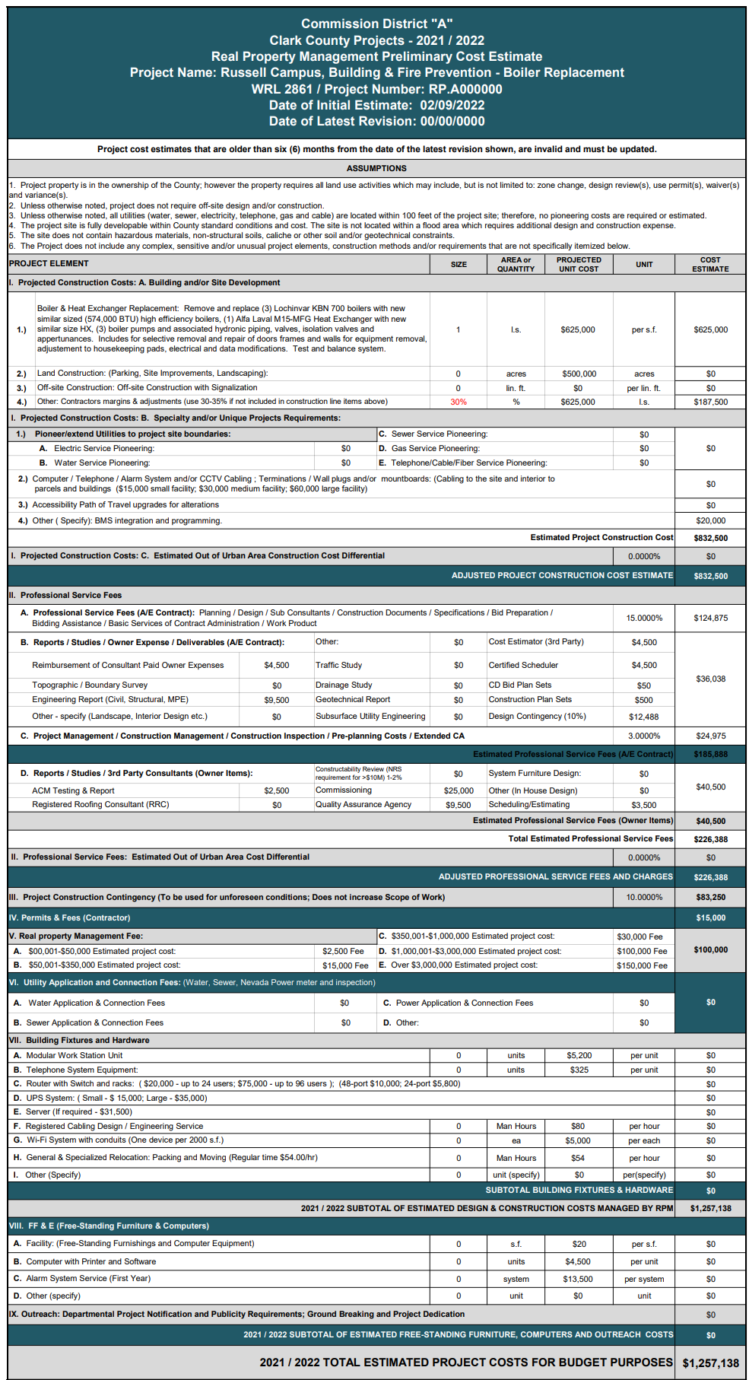
Boiler Replacement – Cost Estimate

Slide 12
Capital project requests
Russell Campus Chiller 3 Replacement - $858,314
Scope of Work
Replacement of 3rd chiller at Russell Campus with high efficiency chiller to be compatible with the other two chillers currently in design for their replacement.
Current chillers are reaching end of useful service period. There currently a project funded for chiller replacement which did not include the 3rd chiller.

Slide 13
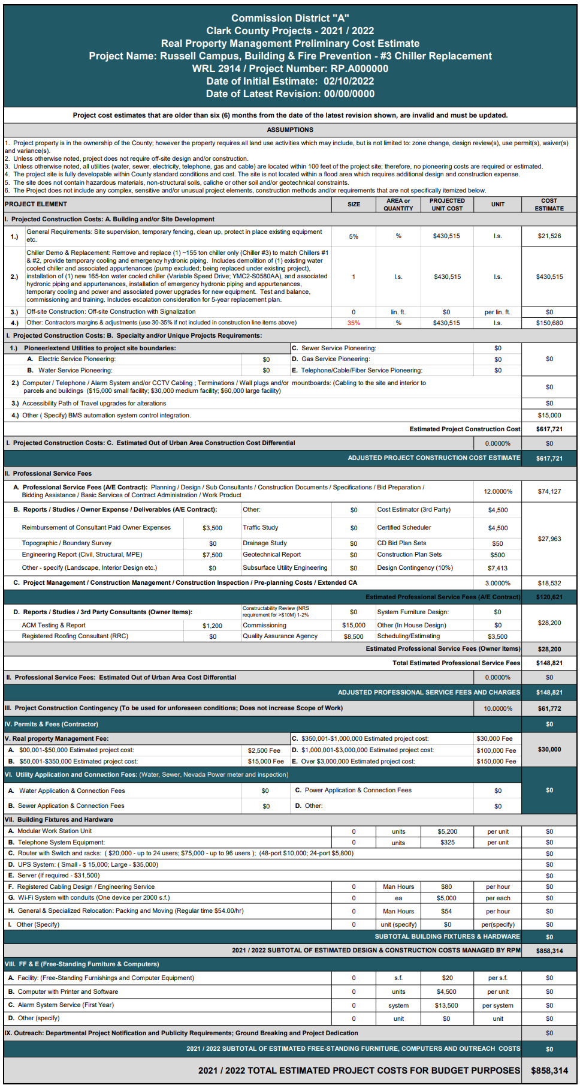
Chiller 3 Replacement – Cost Estimate

Slide 14
Capital project requests
Covered Parking (non-solar), Phase I - $1,311,310
Phase II – 2,079,012
Phase III – 1,606,722
Total: $4,997,044
Scope of Work
Install shade structures to provide covered parking within the secured employee parking area.
This is similar to a previous request, however, the solar panel component was deleted from the scope. The solar panel version costs were
Phase I - $ 3,085,489
Phase II - $ 4,879,548
Phase III - $ 3,736,722
Total $11,701,759
Cover parking help to reduce heat island impacts and light pollution, all in alignment with the County’s sustainability initiative.

Slide 15
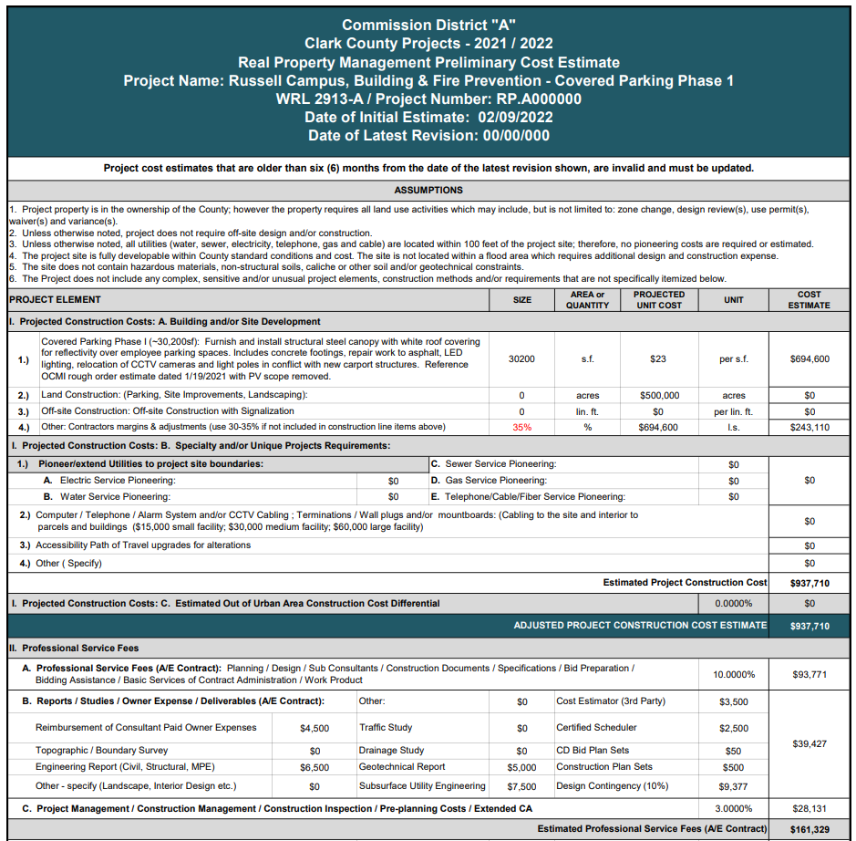
Covered Parking Phase 1

Slide 16
Covered Parking Phase 2

Slide 17
Covered Parking Phase 3

Slide 18
Capital project requests
Russell Campus Secure Parking Gate Replacements - $413,451
Scope of Work
Replacement of the gates and operators at 4 locations providing access to the secure parking area.
RPM Operation note a significant number of work order to repair these gates and operators.

Slide 19
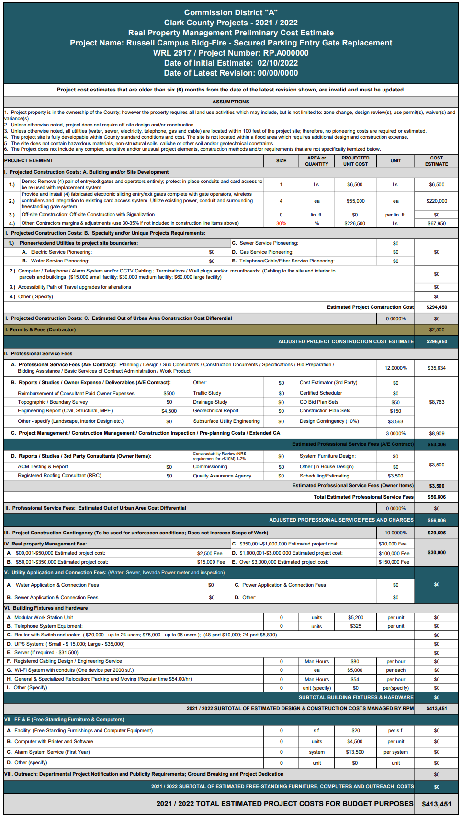
Parking Lot Gate & Controller Replacement – Cost Estimate

Slide 20
Capital project requests
Russell Campus Permit Intake Cubicle Reconfiguration - $224,954
Scope of Work
Reconfigure the cubicle within the Permit Intake are to provide more cubicles to house current and future staff.
Current cubicle configuration does not provide adequate space for the staff growth that we anticipate may occur with in the next 5 years.

Slide 21
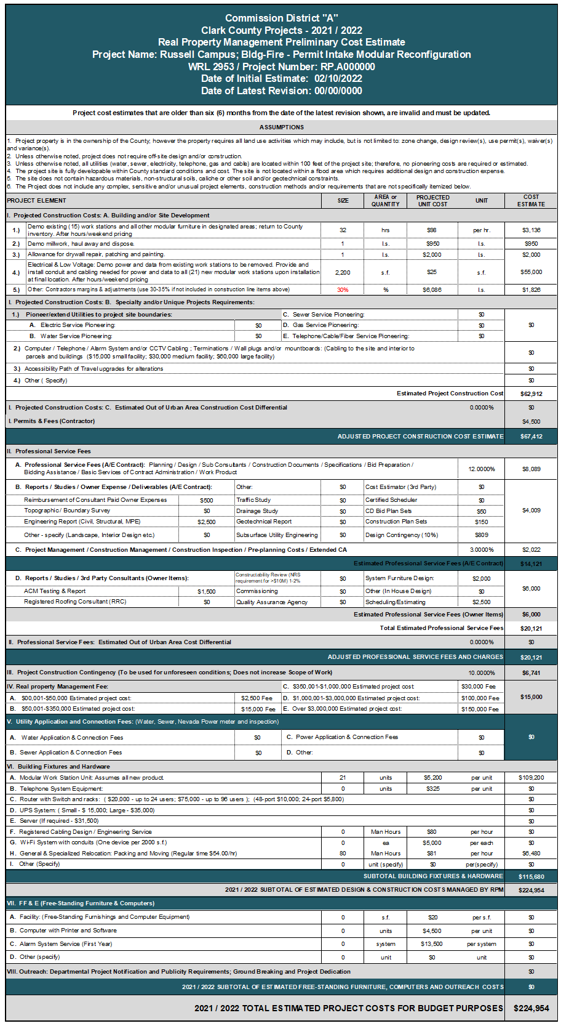
Cubicle Reconfiguration Permit Intake – Cost Estimate

Slide 22
Capital project requests
Russell Campus Presentation Room – Sound System Upgrade - $287,823
Scope of Work
Upgrade the sound system, including the microphones, to provide a more consistent sound level without feedback.

Slide 23
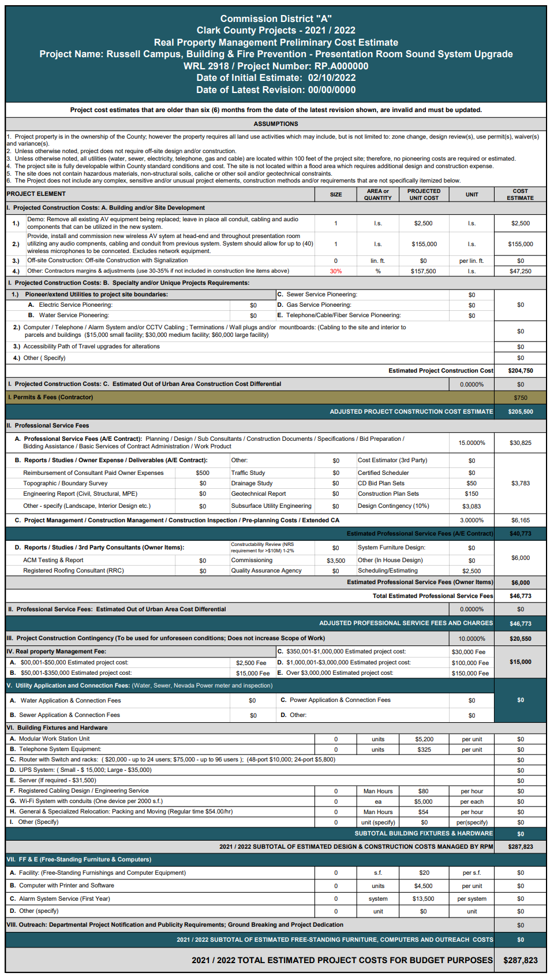
Sound System Upgrade Presentation Room– Cost Estimate

Slide 24
Capital project requests
Russell Campus Room 1116 A/V Upgrade- $133,458
Scope of Work
Replace the existing A/V system with a 100” smart board, video camera and audio system.
Currently the department is set-up to hold either video conference meetings or in person meetings, though hybrid meetings (in-person and video) are difficult. This upgrade will help the Department stay current with the needs of our customers as it relates to meeting format.

Slide 25
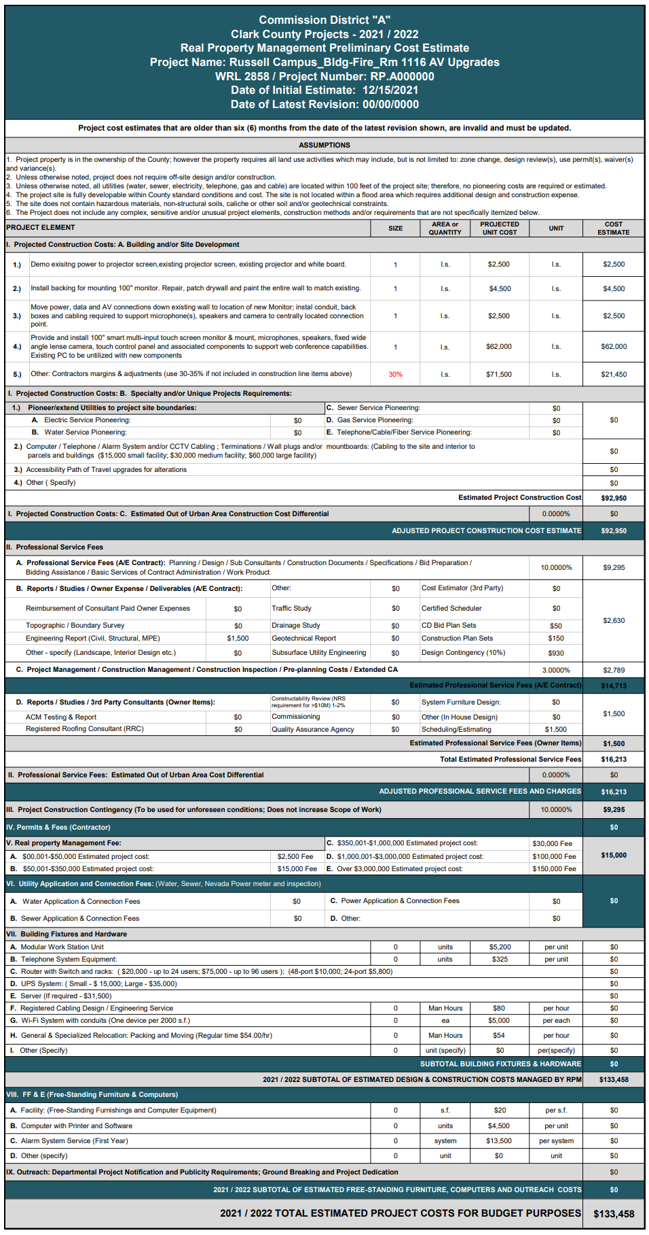
Room 1116 Audio/Visual Upgrade – Cost Estimate

Slide 26
Capital project requests
Russell Campus Rms 1116 and 1222 – Floor Video Ports - $147,976
Scope of Work
Install Conduits and conductor to connect data ports in conference room tables to the A/V connection in Rooms 1116 and 1222 at the Russell Campus.

Slide 27
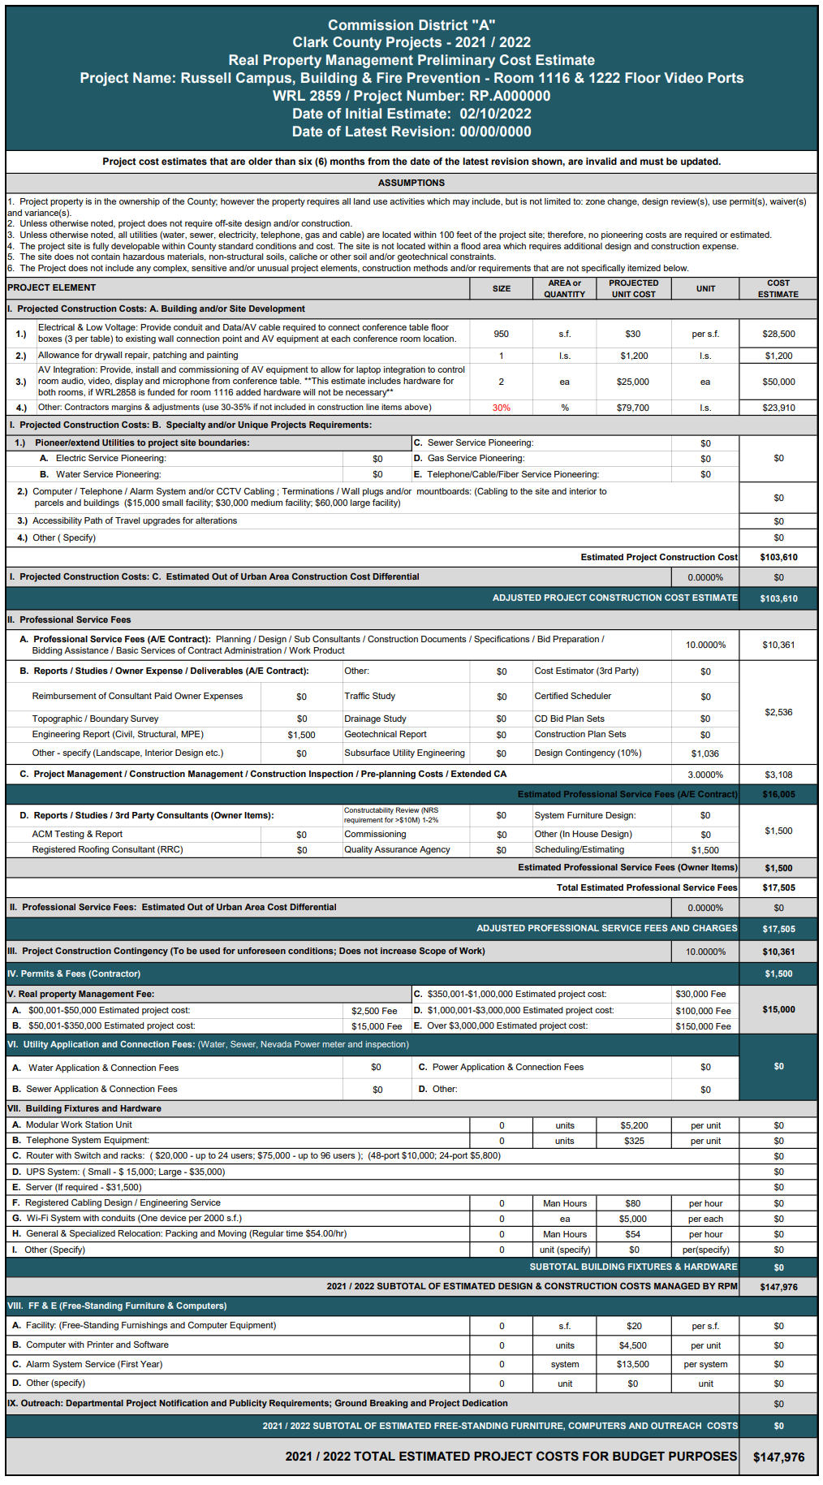
Room 1116 & 1222 Floor Video Ports – Cost Estimate

Slide 28
Capital project requests
Russell Campus Space Needs Assessment - $203,555
Scope of Work
Hire a consultant to conduct space 5 and 10 year space needs assessment for all current and future occupants of the Russell Campus, include Building, Fire Prevention Comprehensive Planning, CCPro\Animal Control, Automotive and Environment & Sustainability.

Slide 29
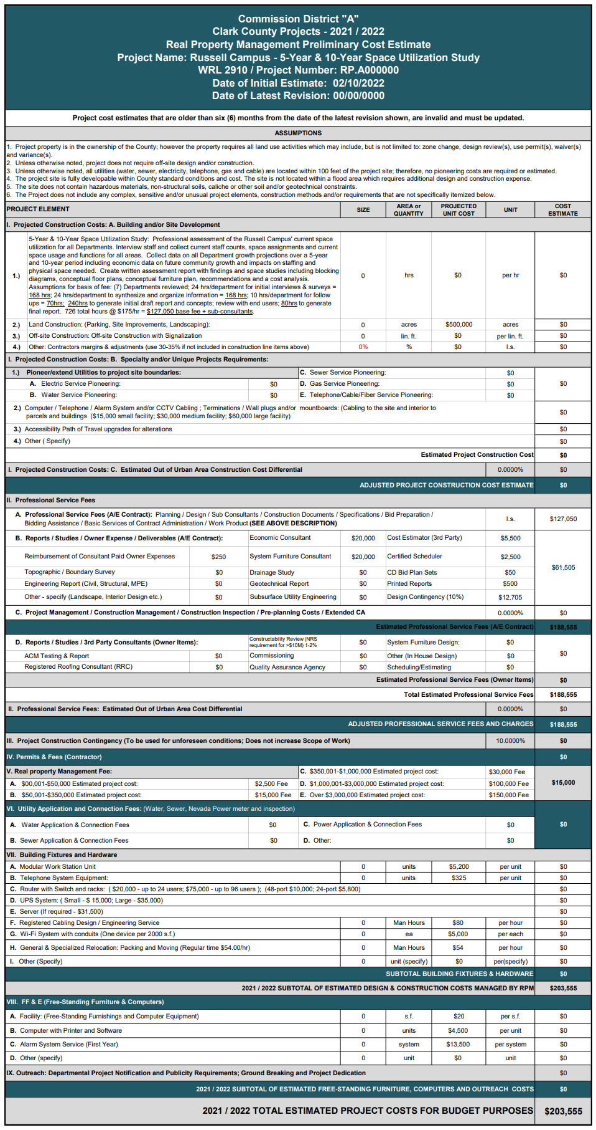
Space Planning Needs – Cost Estimate

Slide 30
Capital project requests
Russell Campus Air-Water Balance – $2,681,858
Scope of Work
Perform a building-wide air and water balance, replacement of the water mixing valves, VAVs and fire dampers, as appropriate.
Work to occur after completion of the boiler and chiller replacement projects.

Slide 31
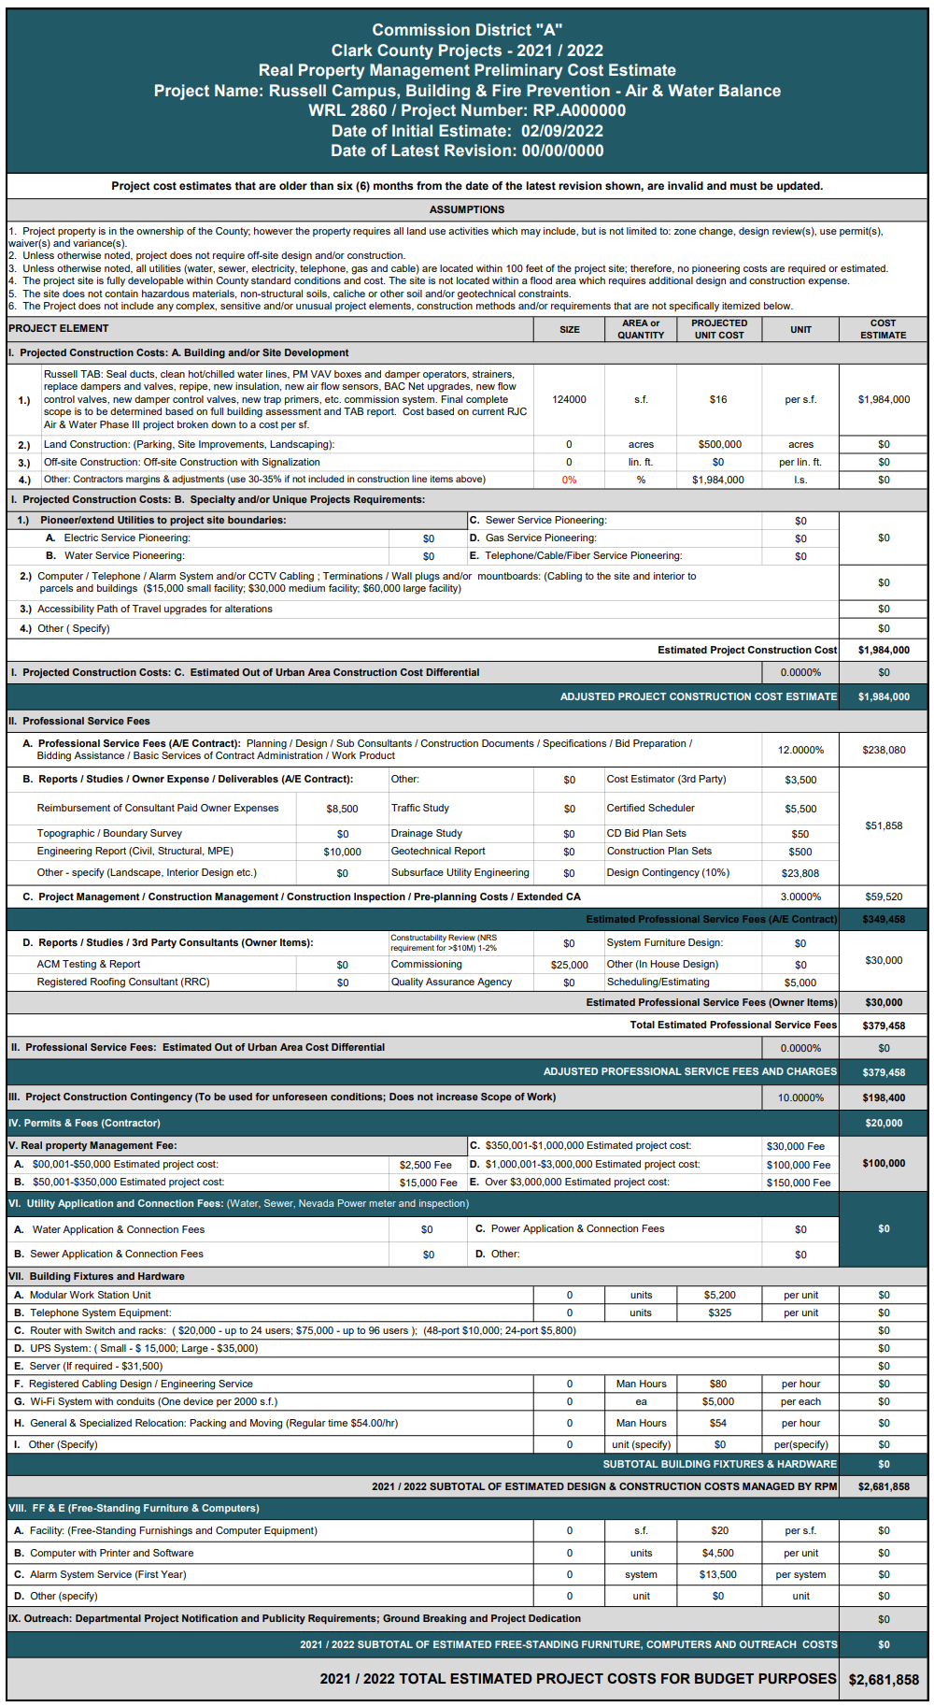
Air & Water Balance – Cost Estimate

Slide 32
Capital project requests
Russell Campus Fire Alarm System Upgrades- $1,324,698
Scope of Work
Upgrade the fire alarm control panels, detectors and alarm devices to meet the current Code.
RPM Operations has identified the system as nearing the end of system functional life.

Slide 33
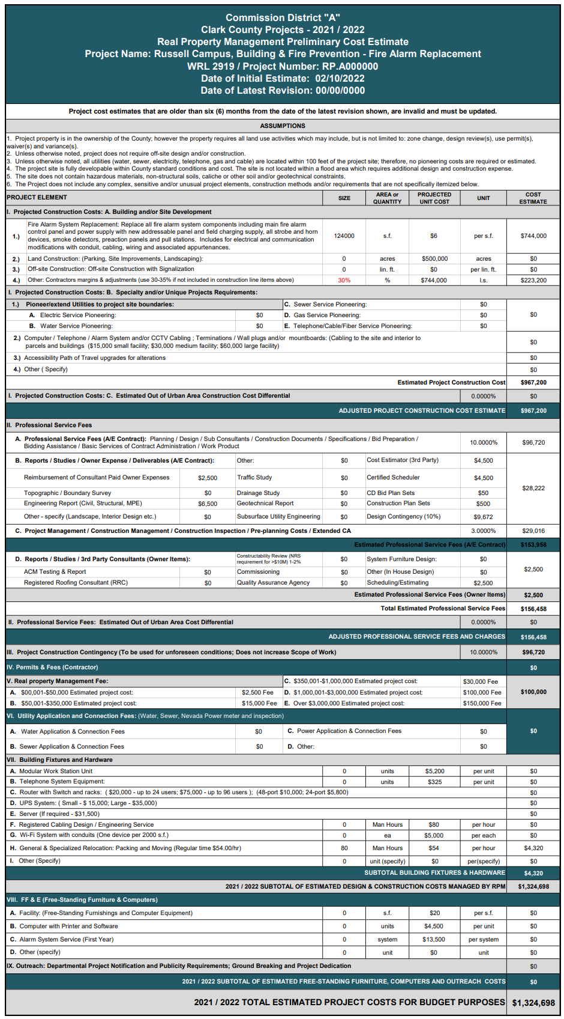
Fire Alarm Replacement – Cost Estimate

Slide 34
CAPITAL IMPROVEMENT REQUESTS
The following capital projects were submitted in the Department 5 -Year capital plan and are presented to the BEFAC for discussion and possible action:
LED Lighting Upgrade $ 2,080,968
Boiler Replacement $ 1,257,138
Chiller 3 Replacement $ 858,314
Covered Parking $ 4,997,044
Parking Lot Gate & Controller Replacement $ 413,451
Cubicle Reconfiguration – Permit Intake $ 224,954
Sound System Upgrade – Presentation Room $ 287,823
Room #1116 Audio/Visual Upgrade $ 133,458
Room #1116 and #1222 Floor Video Ports $ 147,976
Space Planning Needs-Russell Campus $ 203,555
Air-Water Balance - Russell Campus $ 2,681,858
Fire Alarm Systems Replacement $ 1,324,698
TOTAL $14,611,237

Slide 35
CAPITAL IMPROVEMENT PROJECT UPDATE

Slide 36
CAPITAL IMPROVEMENT UPDATES:
Status on previously approved capital improvement projects:
Plans Exam Restroom
Covered Parking (Photovoltaic)
Carpet Replacement
ADA Code Accessibility
Public & Employee Parking LED Light Change
Smart TV Relocation and New Installation
Parking Lot Assessment
2 Chiller Replacements
Data Room Cooling
Exterior Joint Sealant Replacement
Interior Camera VMS Upgrade
Lighting Control System Replacement

Slide 37
Valuation Table Update

Slide 38
Departmental PERFORMANCE Data

Slide 40
Building Permits Issued - Fiscal Year Comparison Through April 2022
 | JUL | AUG | SEPT | OCT | NOV | DEC | JAN | FEB | MAR | APR | MAY | JUN | YTD
FY18 | 4,632 | 5,239 | 4,302 | 4,646 | 4,406 | 3,866 | 4,223 | 4,058 | 4,934 | 4,781 | 5,346 | 5,047 | 55,480
FY19 | 4,946 | 5,579 | 4,177 | 5,237 | 4,486 | 3,729 | 4,424 | 4,584 | 4,657 | 5,148 | 4,926 | 4,922 | 56,815
FY20 | 5,480 | 4,570 | 3,919 | 4,704 | 3,418 | 3,714 | 4,621 | 4,088 | 3,726 | 3,308 | 3,479 | 4,678 | 49,705
FY21 | 4,718 | 4,849 | 5,179 | 4,609 | 3,924 | 5,141 | 4,777 | 4,516 | 5,168 | 5,200 | 5,211 | 5,868 | 59,160
FY22 | 5,007 | 6,187 | 4,757 | 5,068 | 4,823 | 5,063 | 5,004 | 5,075 | 5,482 | 4,739 |  |  | 51,205

Slide 42
Building Completed Inspections- Fiscal Year Comparison Through April 2022
 | JUL | AUG | SEPT | OCT | NOV | DEC | JAN | FEB | MAR | APR | MAY | JUN | YTD
FY18 | 22,626 | 26,980 | 26,459 | 25,020 | 22,778 | 27,768 | 22,870 | 21,398 | 24,830 | 23,942 | 25,426 | 24,443 | 294,540
FY19 | 23,689 | 25,729 | 21,795 | 26,588 | 23,249 | 22,133 | 23,008 | 20,788 | 23,326 | 22,801 | 23,779 | 21,080 | 277,965
FY20 | 22,187 | 21,963 | 20,661 | 23,024 | 18,050 | 18,977 | 20,933 | 19,986 | 20,557 | 19,241 | 16,963 | 19,664 | 242,206
FY21 | 20,440 | 19,376 | 20,604 | 20,062 | 17,055 | 19,487 | 17,307 | 18,928 | 22,626 | 21,014 | 20,078 | 23,290 | 240,267
FY22 | 20,791 | 21,925 | 21,764 | 20,779 | 22,321 | 21,774 | 22,023 | 22,316 | 27,561 | 23,712 |  |  | 224,966

Slide 45
BUILDING INSPECTOR ACTIVITY
Rollover Data by Fiscal Year
 | FY18 | FY19 | FY20 | FY21 | FY22
Rollover Data | 2.02% | 1.63% | 1.40% | 3.36% | 3.34%
1.40%
3.34%

Slide 46
Staffing update

Slide 47
Staffing Updates
New Hires
Building Permit Specialist I | 11/29/2021 | Nicole Cowens
Building Permit Specialist I | 11/29/2021 | Dani Elle Russo
Building Permit Specialist I | 12/27/2021 | Rosa Melo
Building Inspector I | 2/22/2022 | James Hedges
Building Inspector I | 5/2/2022 | Travis Lewis
Building Permit Specialist I | 3/21/2022 | Ryan Watanabe
Administrative Secretary | 3/7/2022 | Cedrick Wilson
Building Inspection Specialist | 3/21/2022 | Jessie Keller
Building Inspector I | 4/18/2022 | Aaron Kemper
P/T Management Assistant | 2/22/2022 | Katie Bradley
Senior Building Inspector | 5/16/2022 | Doug Petty
P/T Management Assistant | 4/18/2022 | Ava Arroyo

Slide 48
Staffing Updates
Promotions
Commercial Combination Inspector | 11/29/2021 | Glenn Weidman
Senior Building Inspector | 12/13/2021 | Ramon Carrillo
Assistant Manager Plans Exam | 2/22/2022 | Mary Audrey
Commercial Combination Inspector | 2/22/2022 | Michael Metz
Director Development Services | 4/4/2022 | James Gerren
Sr. Engineer/Architect | 3/7/2022 | Paul Simpson
Senior Building Inspector | 5/16/2022 | Steven Crofford
Senior Engineer/Architect | 5/16/2022 | Belayhun Gebretsadik
Offers Made Pending Background Check
Building Inspector I | Pending | Brian Forest
Part-Time | Pending | Markus Gharibian

Slide 49
Staffing Updates
Positions in Recruitment
10007541 | Sr. Office Specialist
10007784 | Associate Engineer
10007549 | Associate Engineer
10007876 | Associate Engineer
10007775 | Building Inspector I/II
10007762 | Building Inspector I/II
10040723 | Building Plan Exam. Specialist
10037992 | Building Plan Exam. Specialist
10036962 | Building Plan Exam. Specialist
10037153 | Building Plan Exam. Specialist
10007694 | Fire Protection Engineer
10007701 | Manager Engineering
10007780 | Sr. Building Inspector
10007663 | Sr. Building Inspector
10007770 | Sr. Building Inspector
10007856 | Sr. Engineer/Architect
10008964 | Records Technician
10007611 | Records Technician
10050098 | Sr. Management Analyst

Slide 50
Staffing Updates
Additional Positions Seeking Authority to Recruit
10007703 | Office Assistant II
10007704 | Office Assistant II
Additional Funded Positions in Holding
10007540 | Administrative Specialist
10007703 | Manager Plans Exam
10007638 | Assistant Director
10007774 | Sr. Building Inspector
10007802 | Sr. Building Inspector
10007807 | Sr. Building Inspector
10007827 | Sr. Building Inspector
10007829 | Sr. Building Inspector

Slide 51
Economic Outlook
From BEFAC Members

Slide 52
Proposed items for future agenda

Slide 53
DIRECTOR’S COMMENTS

Slide 54
Set next committee meeting
August 2022

Slide 55
Public comment

Slide 56
Adjourn meeting

